Slide 1


GURUNANAK INSTITUTE OF TECHNOLOGY
SUBJECT: CIRCUIT THEORY AND NETWORK
PAPER CODE: EC 302
TOPIC: OXIMETER
STREAM: ECE2
3RD SEMESTER

Slide 2
GROUP B:
GROUP MEMBERS NAME ROLL NO
ATRAJIT DEBNATH 71
PREM KUMAR MONDAL 72
ESHIKA ROY 73
SAYAN ROY 74
SMITA KUNDU 75

Slide 3
INTRODUCTION:
WHAT IS OXIMETER?
Pulse oximetry is a non-invasive method for monitoring a person's oxygen saturation. Though its reading of peripheral oxygen saturation (SpO2) is not always identical to the more desirable reading of arterial oxygen saturation (SaO2) from arterial blood gas analysis, the two are correlated well enough that the safe, convenient, non-invasive, inexpensive pulse oximetry method is valuable for measuring oxygen saturation in clinical use. By which device this process can be done is called PULSE OXIMETER.

Slide 4
HOW IT WORKS?
A pulse oximeter is a tiny device that usually slides over our fingertip or clips on our ear lobe and uses infrared light refraction to measure how well oxygen is binding to our red blood cells.
USES OF OXIMETER:
To assess how well a new lung medication is working.
To evaluate whether someone needs help breathing.
To evaluate how helpful a ventilator is.
To monitor oxygen levels during or after surgical procedures that require sedation.
To determine how effective supplemental oxygen therapy is, especially when treatment is new.
To assess someone’s ability to tolerate increased physical activity.
To evaluate whether someone momentarily stops breathing while sleeping — like in cases of sleep apnea — during a sleep study.

Slide 5
PURPOSE OF USE:
The purpose of pulse oximetry is to check how well our heart is pumping oxygen through your body.
It may be used to monitor the health of individuals with any type of condition that can affect blood oxygen levels, especially while they’re in the hospital. These conditions include:
Chronic Obstructive Pulmonary Disease (COPD)
Asthma
Pneumonia
Lung Cancer
Anemia
Heart attack or Heart failure
Congenital heart defects

Slide 6
PULSE OXIMETER AND COVID PANDEMIC:
EARLY DETECTION OF COVID-19:
Pulse oximeter are used to help with the early detection of COVID-19 infections, which may cause initially unnoticeable low arterial oxygen saturation and hypoxia. The New York Times reported that "health officials are divided on whether home monitoring with a pulse oximeter should be recommended on a widespread basis during Covid-19. Studies of reliability show mixed results, and there’s little guidance on how to choose one. But many doctors are advising patients to get one, making it the go-to gadget of the pandemic.

Slide 7
Due to changes in blood volumes in the skin, a plethysmographic variation can be seen in the light signal received (transmittance) by the sensor on an oximeter. The variation can be described as a periodic function, which in turn can be split into a DC component (the peak value)[a] and an AC component (peak minus trough).[57] The ratio of the AC component to the DC component, expressed as a percentage, is known as the (peripheral) perfusion index (Pi) for a pulse, and typically has a range of 0.02% to 20%.[58] An earlier measurement called the pulse oximetry plethysmographic (POP) only measures the "AC" component, and is derived manually from monitor pixels.
This situation gave us the idea of making this project.

Slide 8
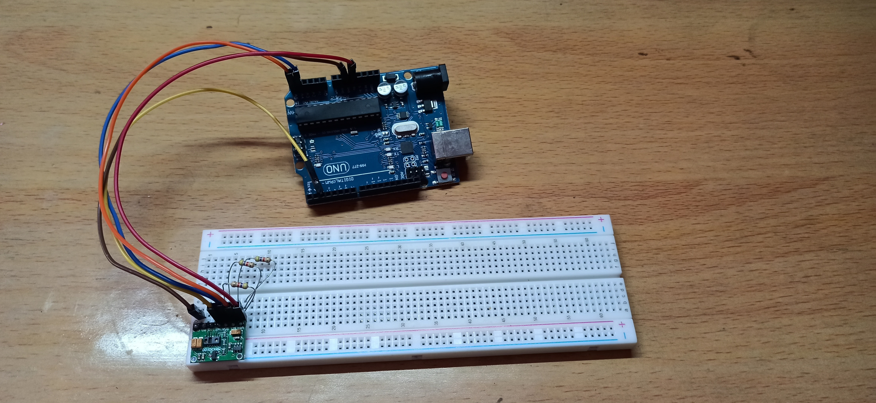
WORKING MODEL OF PULSE OXIMETER:

Slide 9
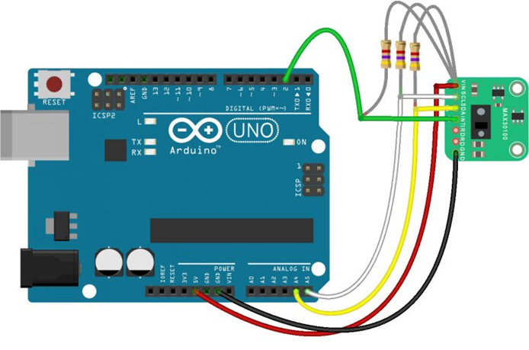
CIRCUIT DIAGRAM OF THE MODEL:

Slide 10
COMPONENTS WE USED:
ARDUINO UNO
MAX30100 PULSE OXIMETER SENSOR
BREAD BOARD
THREE 4.7K RESISTORS
JUMPER WIRES

Slide 11
THANK YOU

